Slide 1
Zomato
Restaurant Data Analysis
By
Ashish Suryavanshi

Slide 2
Problem Statement
The goal of this project to recommenced new country and new city for open new Zomato restaurants in different country ,so I will analyze the whole data than I will decide to some criteria.
Analyze the expenditure on food.
Analyze the competitors.
Analyze the average restaurants rating.
Analyze the market trends and Online deliveries and table bookings.
Analyze the customer preference .

Slide 3
Data Overview
I analyze whole data in the raw data many column and row .the column name are country, city name, restaurants name ,rating, cuisines, price , online delivery and table booking.
First thing i do clear the duplicate value and remove the null value .
After data cleaning and preprocessing, we enhanced the dataset by adding additional attributes such as country information and average cost for two.“
Raw Data having 20 attributes
Modified Data having 24 attributes.

Slide 4
Methodology
"We used Excel for data cleaning, preprocessing, visualization and analysis.
Key steps included handling missing values, adjusting formats, conditional formatting, lookup function, statistical function.
For good insight using pivot tables to uncover strategic insights.
Visualized data with charts and graphs
After used this methodology We focused on identifying potential markets with low competition and opportunities for higher customer satisfaction.

Slide 5
Analysis – Opening
Our analysis identified four countries with the potential for opening new Zomato restaurants.
Country name
Australia,
Canada,
Singapore
Sri Lanka.

Slide 6
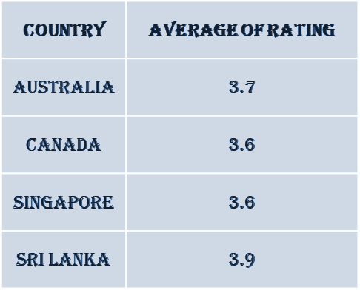
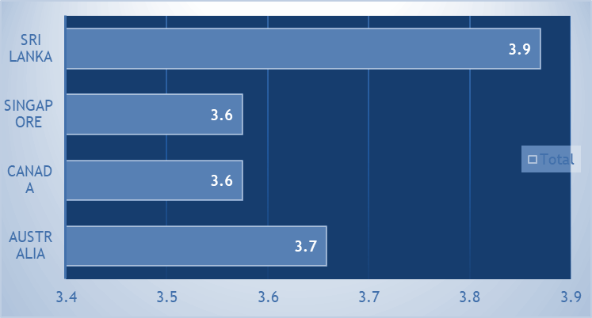
Analysis
New Restaurant Locations:
. We chose these countries based on two factor.
Lower competition.
The average restaurant ratings.

Slide 7
Analysis
Competitor Analysis:
We examined competitors in the suggested countries.
Some of the top competitors Restaurants Name-
1918 Bistro & Grill in Australia
Simply Strawberries by Jagro in Canada.
We also identified poorly rated restaurants like Poets Café, which presents an opportunity for us to enter the market with superior service."

Slide 8
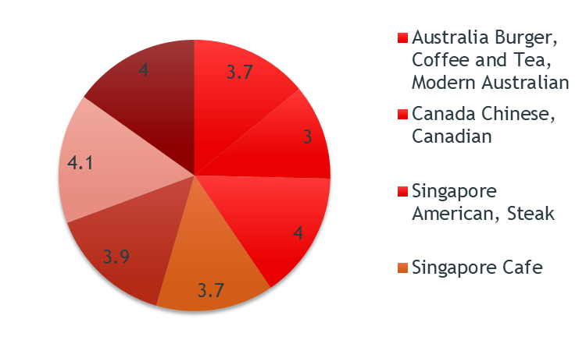
Analysis
Cuisine Recommendations:
These are the highest rated cuisines in all the four suggested countries.
Top preferred cuisines is seafood in all the 4 countries.
Cuisines with highest rating
Burger
Pizza
Sea Food
Australian
American

Slide 9
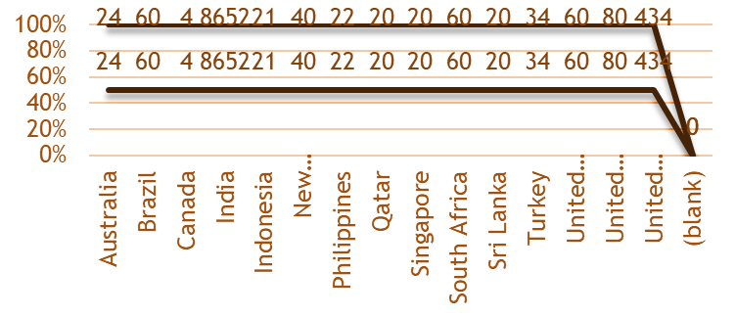
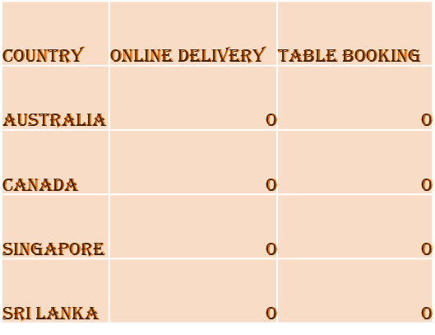
Analysis
Online Delivery and Table Booking:
Selected four counties doesn’t provide online Delivery and table booking options to their customers.
This presents a unique opportunity for Zomato to fill this gap, providing a competitive edge in these markets.
We should go for table booking and online delivery. As none of the restaurants are providing this facility.

Slide 10
Strategic Recommendations
To summarize our recommendations: Zomato should open new restaurants in Australia, Canada, Singapore, and Sri Lanka.
Offering a diverse menu will boost customer satisfaction, and investing in online delivery and table booking services can set Zomato apart from competitors."

Slide 11
Strategic Recommendations
Competitor Analysis:
Recommendation: Learn from biggest competitors and address issues highlighted by low-rated restaurants.
Justification: Understanding competitors' strategies can inform improvements.
Culinary Pricing Strategy:
Recommendation: Adjust prices based on cuisine preferences and customer feedback.
Justification: Price adjustments can optimize profitability while maintaining satisfaction.
Financial Control:
Recommendation: Monitor food expenditure closely for financial sustainability.
Justification: Understanding expenditure levels ensures financial health.
Marketing and Promotion:
Recommendation: Invest in targeted marketing campaigns.
Justification: Effective marketing drives foot traffic and increases restaurant visibility.

Slide 12
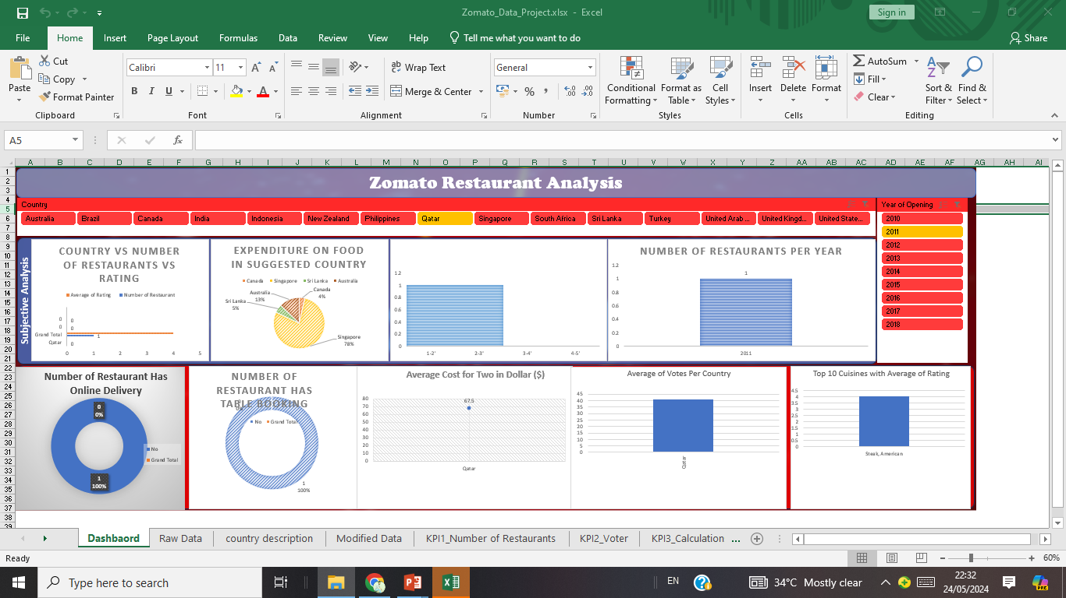
Dashboard and Visualizations

Slide 13
Acknowledgements
We would like to express our gratitude to “Rishabh Varma” for their valuable guidance throughout Excel Model.

Slide 14
References
Dataset: Provide by “Newton School”
Other Resources: PNG from “Google”

Slide 15
ThanksYou

